Slide 1
ENG ALL HANDS
SEPT EDITION - Bug Triage & Release Data
Notes:
Anton + Paul: WELCOME!
Agenda:
Update from AJ
Engineering metrics
TDD & BDD (Anton note on importance)
Tab count today: 80

Slide 2
Questions on the chat only

Slide 3
Brief update from AJ

Slide 4



AJ’s brief update
Healthy teams
“Engineering-Led skills staffing”
“Resilience & Sustainable pace” “Capacity & Prioritisation”
Product
Hiring

Slide 5



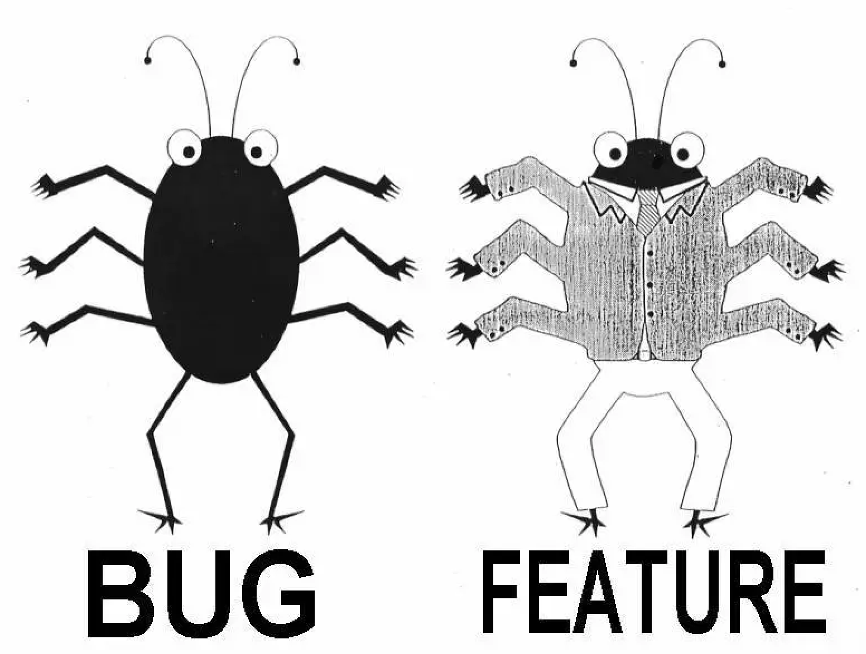

Slide 6
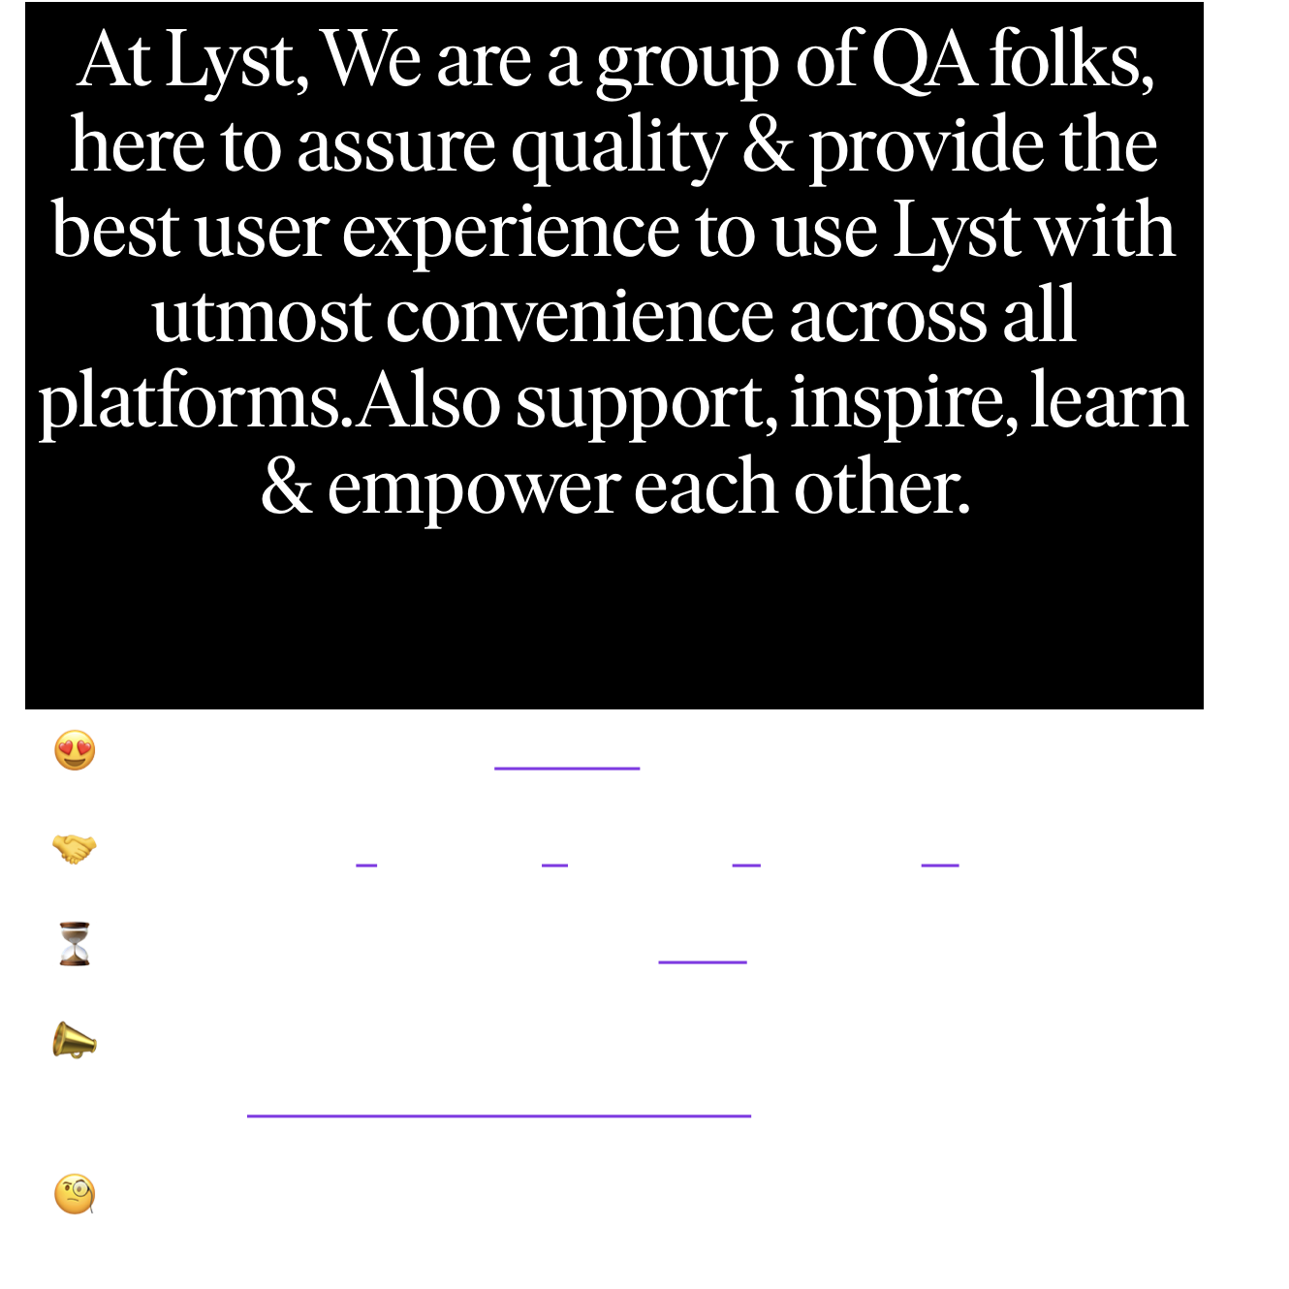

TEAM @app-qa
😍 Passionate (Going beyond what is obvious)
🤝 Team work (Together Everyone Achieves More)
⏳ Quality over speed(Quality NOT Quantity)
📣 Communicative (If something does not work as expected notify as soon as possible)
🧐 Curious (When you are curious, you will find lots of things interesting to do)

Slide 7
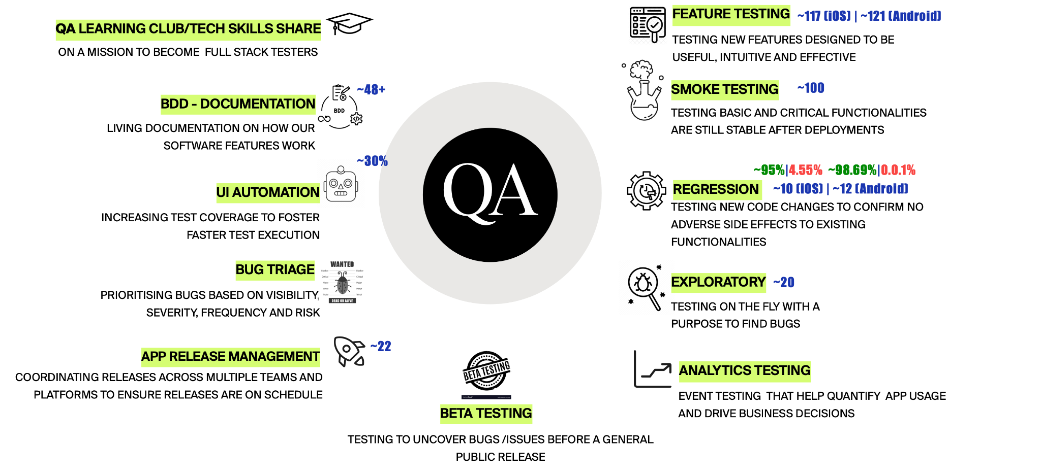
WHAT WE DO?

Slide 8

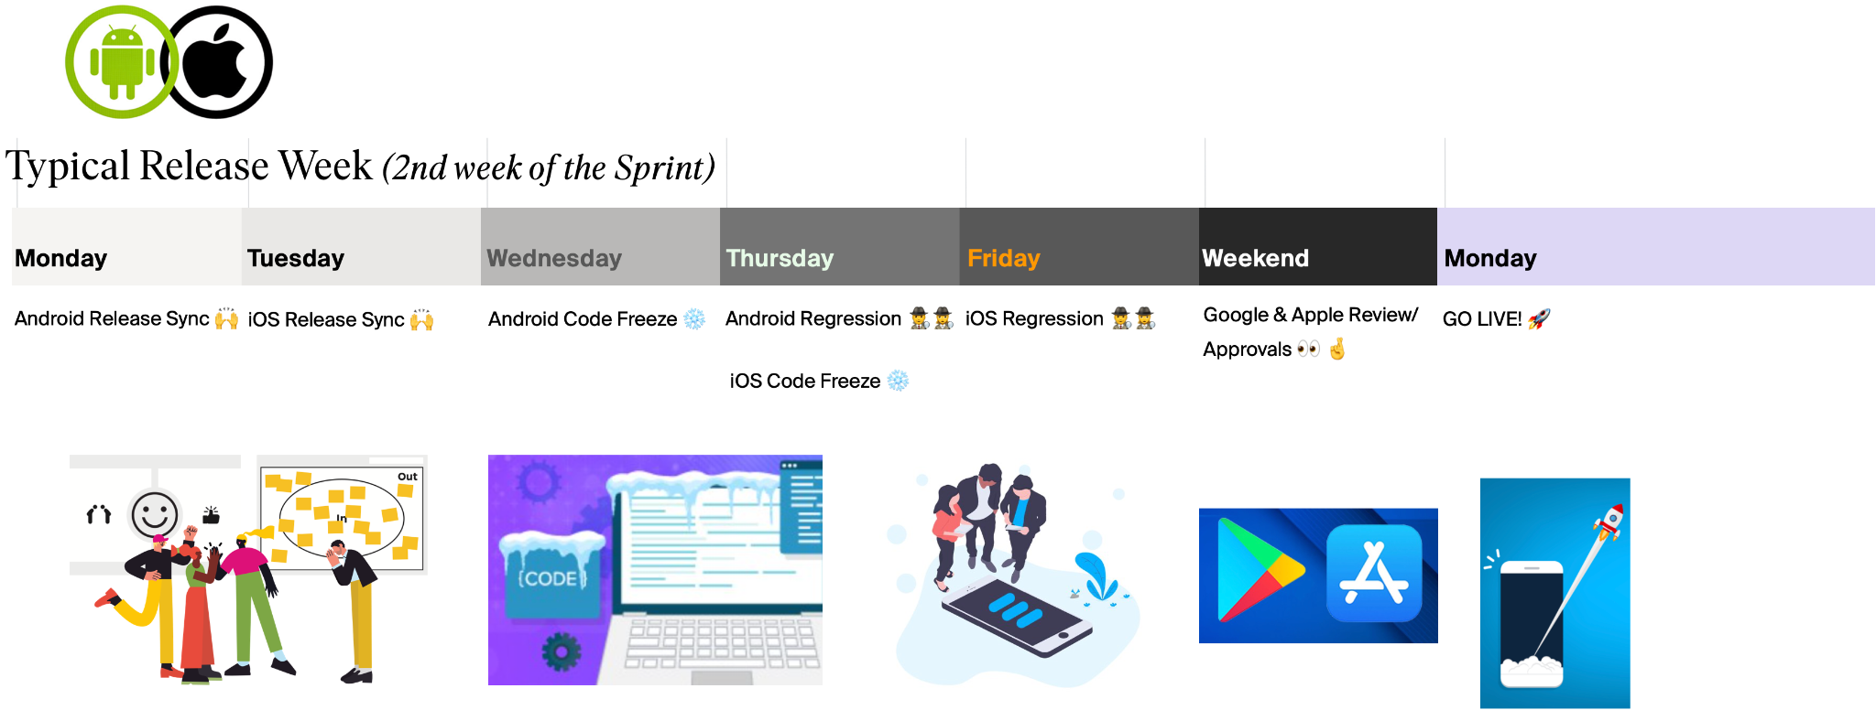
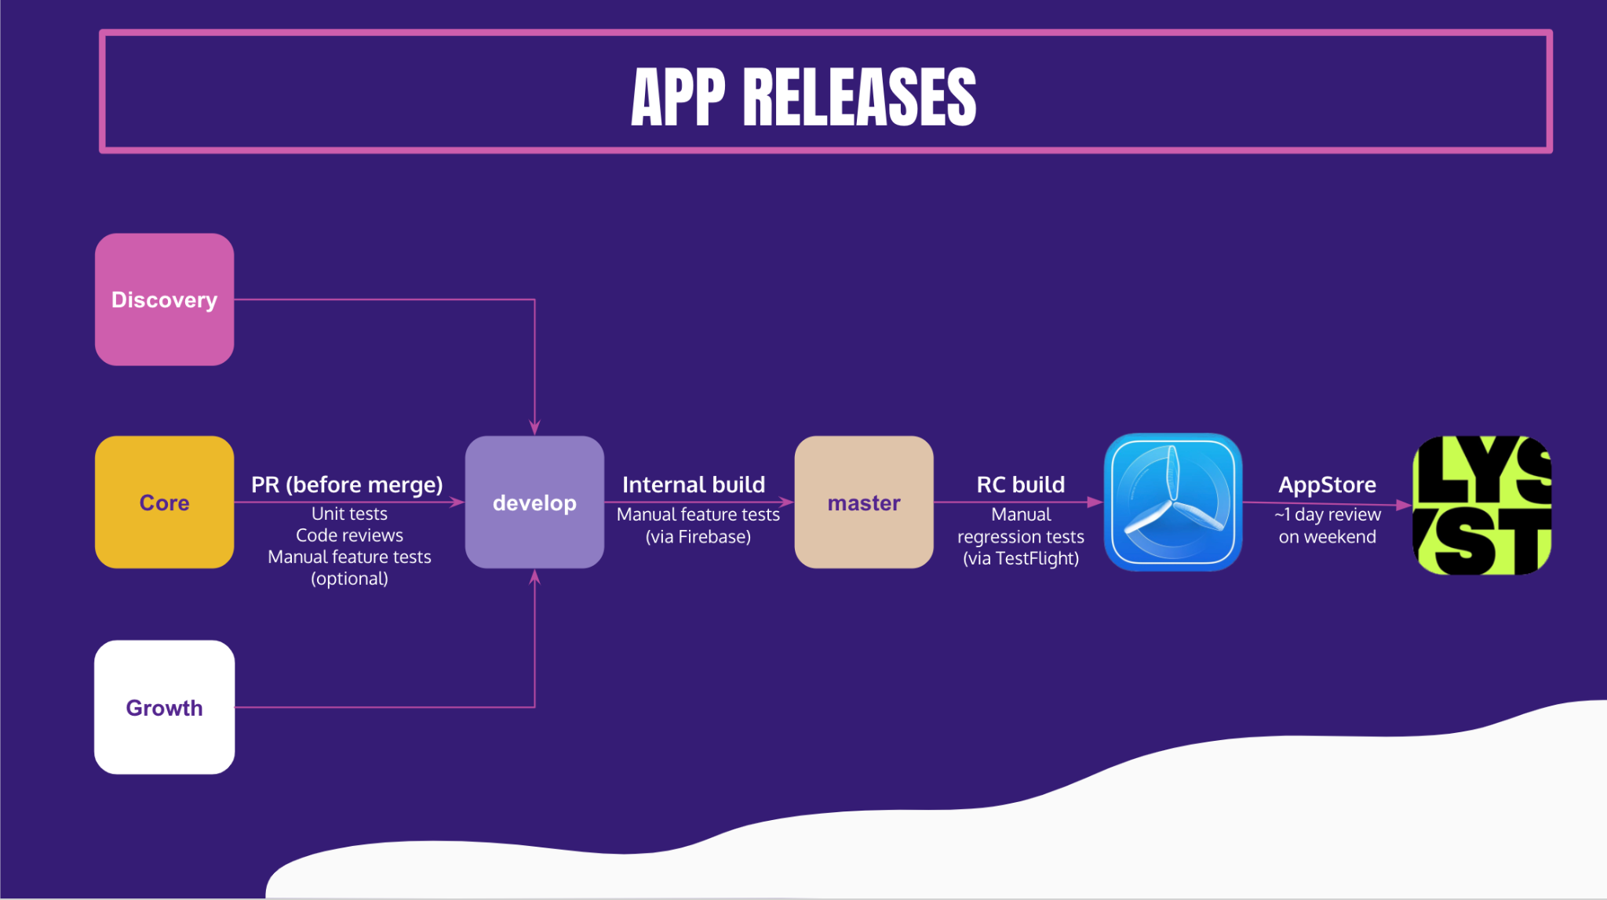
APP RELEASE PROCESS

Slide 9
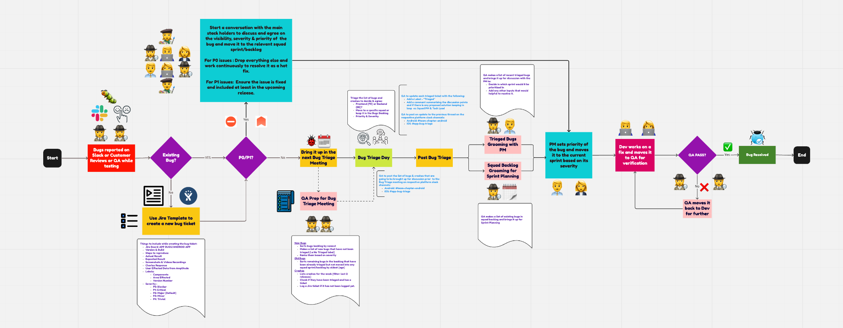
🐛🐞BUG TRIAGE PROCESS

Slide 10
Release Tracking
Matt L

Slide 11
Why track releases
“Observing how our release rate has changed over time will allow for a much richer, less subjective conversation about progress.”
Changes in the baseline for the company / a tribe is an interesting conversation starter for us to explore.

Slide 12
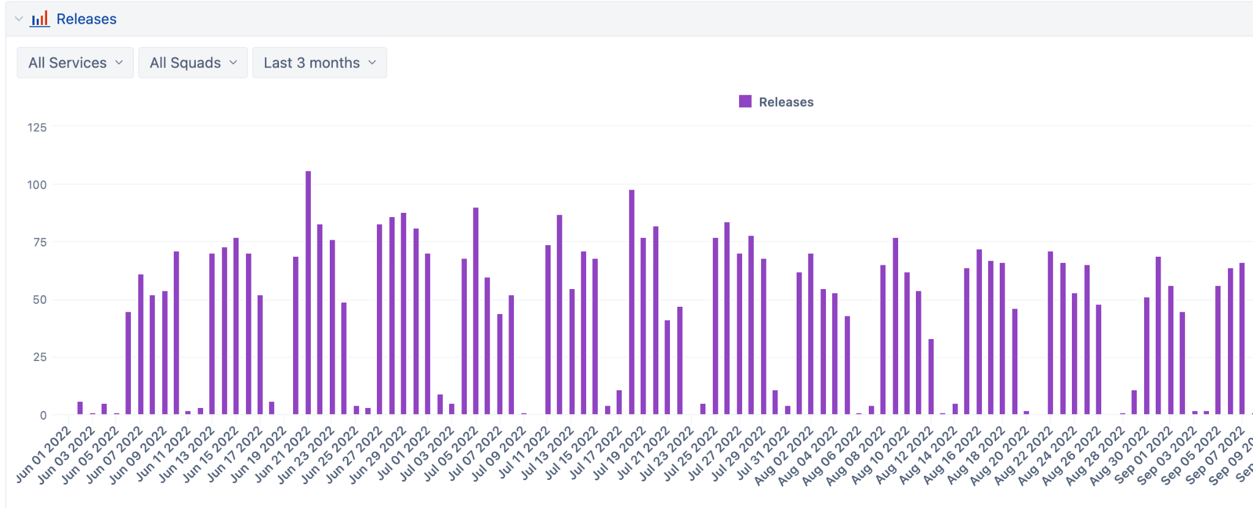
All Releases

Slide 13
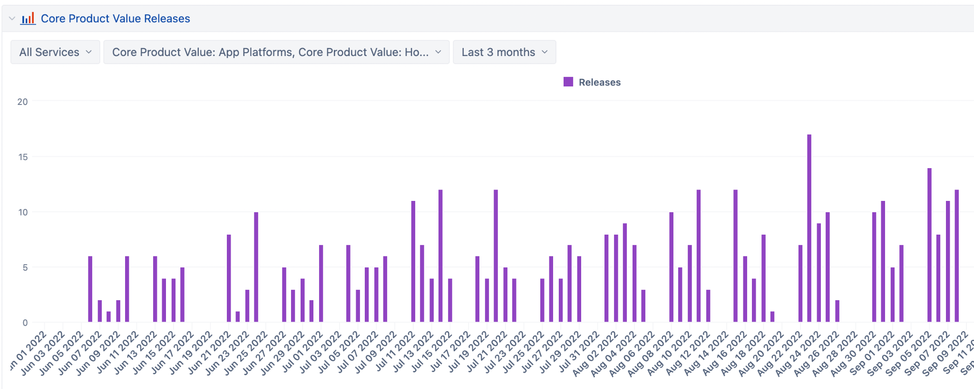
Change to CPV CI

Slide 14
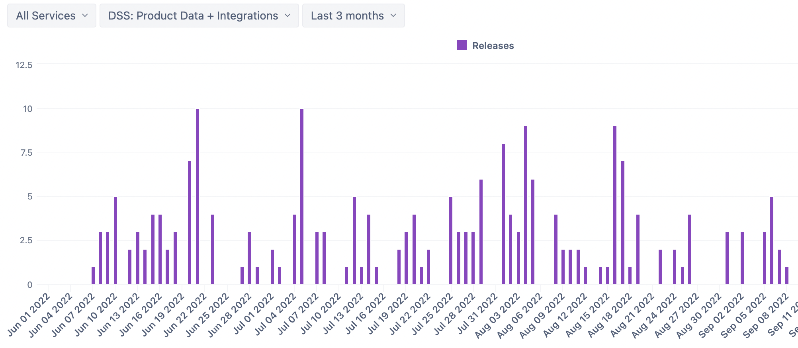
Spot where Igor left

Slide 15
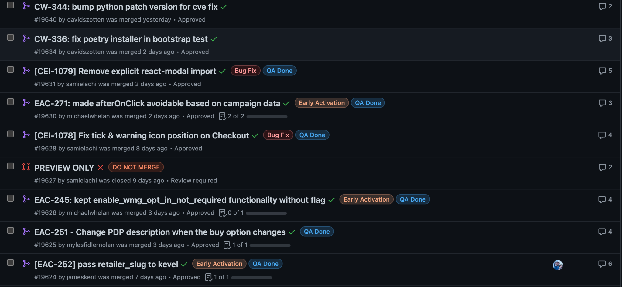
What is a release?
“A pull request that is merged into the default branch and tagged with a jira ticket”
“

Slide 16
What is required for my release to be tracked?
A Jira ticket in your PR title
If you change board names or add a new one, let Paul know

Slide 17
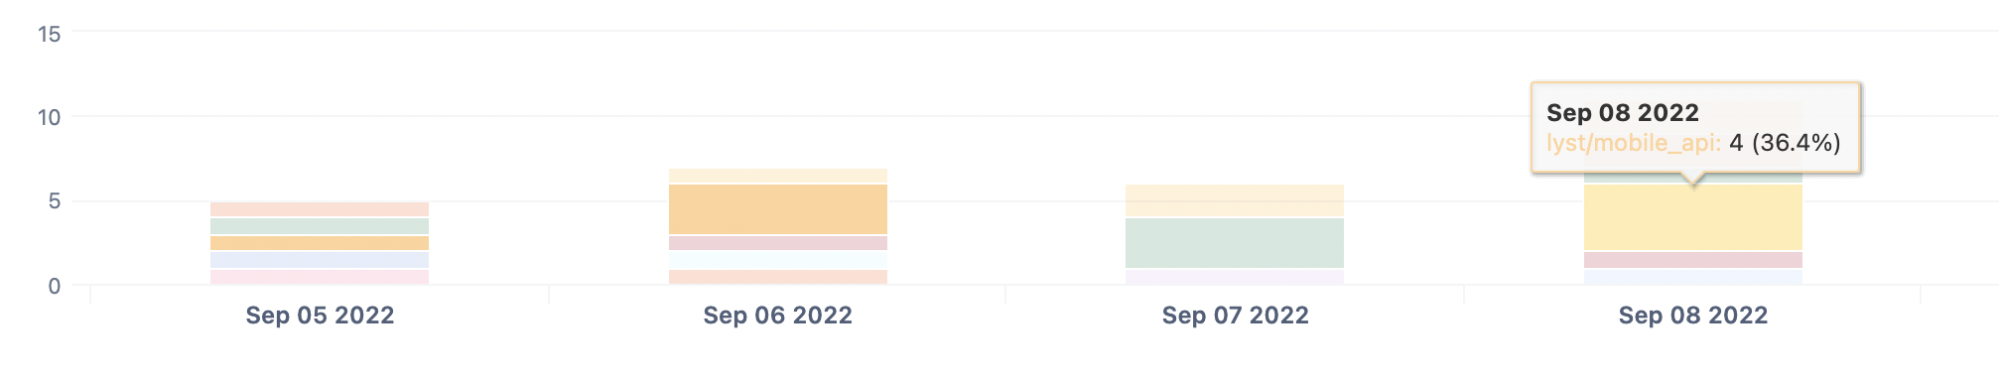
If I don’t tag a PR?

Slide 18
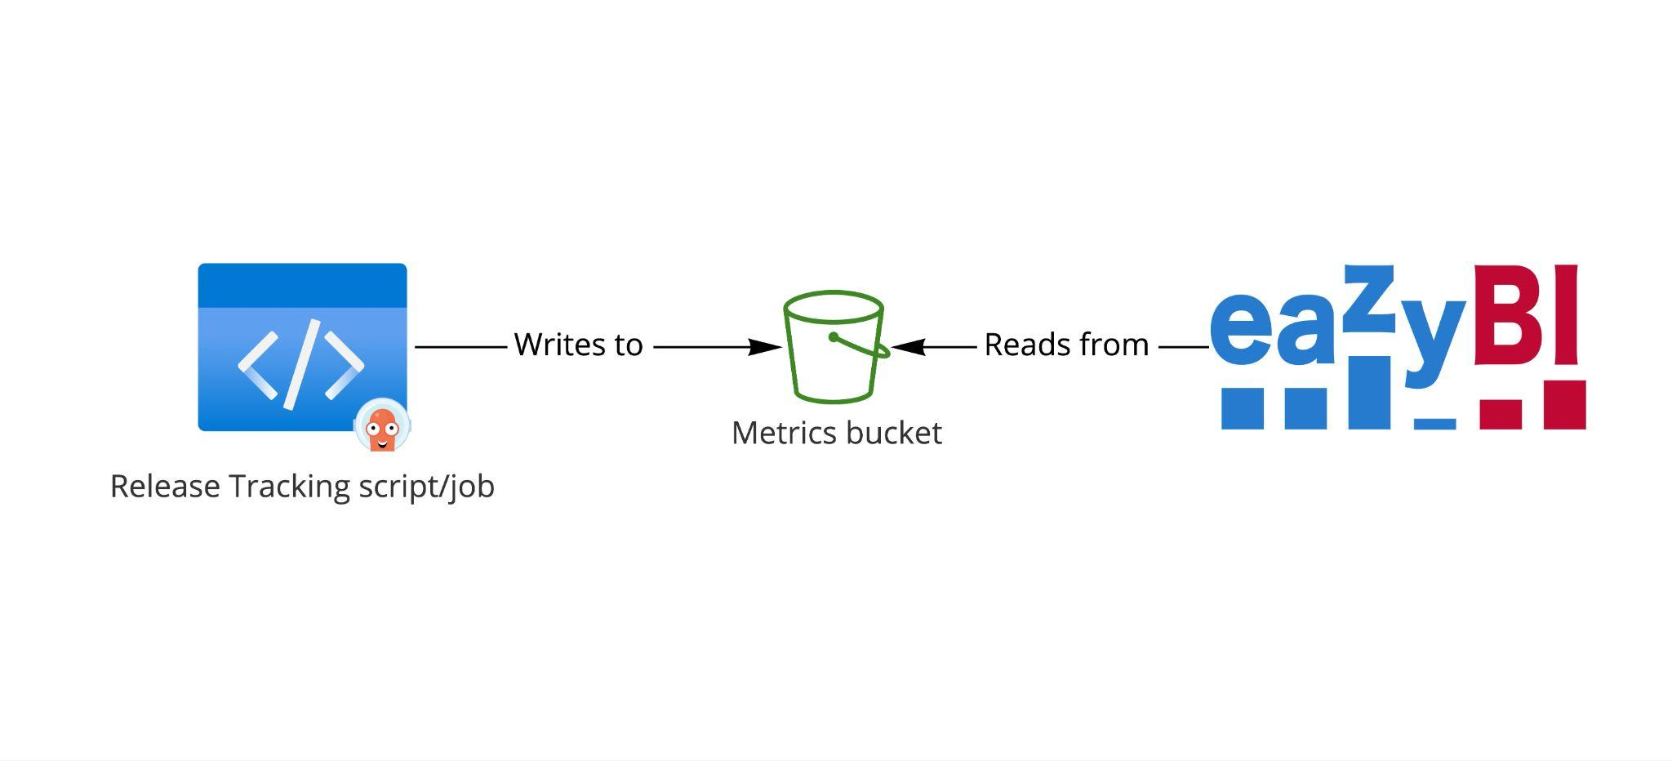
How does it work?

